Slide 1
E205F Preparing for IELTS Unit 3.1
Hazal WONG
hatwong@ouhk.edu.hk

Slide 2
Introduction (p.1)
This module aims to give you practice in a variety of skills and strategies for dealing with academic texts.
In Module 7, you will be asked to apply this ability to reading passages similar to those that might be used in the IELTS reading test.
Module 3 introduces you to some skills and strategies which should help you to improve your comprehension of various kinds of academic texts.

Slide 3
Specifically, you will learn how to:
• orient yourself towards a reading passage and predict its likely content and structure;
• read quickly for main points by focusing on first and last paragraphs and topic sentences;
• read intensively for specific information;
• assess how relationships between ideas and paragraphs are ordered and organized, and note how discourse markers are used;
• determine the meaning of unfamiliar words from context, and knowledge of word forms, word roots, prefixes and suffixes;
• identify possible synonyms for key words and phrases;
• analyse complex sentences to identify their key ideas;
• identify examples and distinguish supporting information from main points;
• identify an author’s opinions, attitudes and bias; and
• assess the intended audience of a text.

Slide 4
Understanding your reading purpose (p.2)
Whenever you begin to read a text, you should try to ask yourself ‘why am I reading this?’
For example, when you read a university course prospectus for the next semester, you are probably trying to find out the aims, content coverage and assessment requirements of a particular programme or course.
Similarly, if you are reading a scientific report on a laboratory experiment, your aim is probably to discover the results and their implications.

Slide 5
Activity 3.1 (p.2)
Think about the following kinds of texts and what your main reading purpose might be as you approach each of them: (Q2 only)
2 a newspaper editorial that is critical of a new government immigration policy
The introduction in the editorial quite closely to establish the writer’s views and his/her position on the policy.

Slide 6
Reading for main points: orienting yourself to a text (p.4)
Reading for the main points entails a number of skills and strategies.
Many of these are related to using your prior knowledge of the structure and language of a text to predict and locate key information.
Skimming skills – such as looking quickly at the title and paragraph topic sentences – are also critical.
As you will see in Module 4, many of the prediction skills and strategies for reading a text effectively can also be applied to improving your listening comprehension.

Slide 7
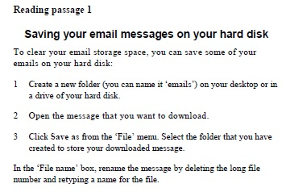
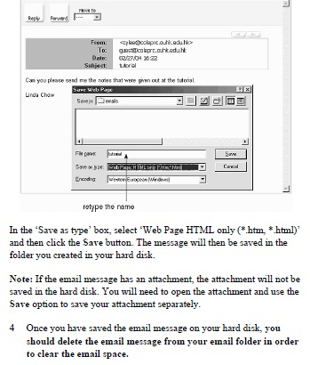
Orienting yourself to a text (P.4)
Look for a minute at the following passage which tells users of the OUHK’s Online Learning Environment (OLE) how to save OLE email messages to their hard disks.
What do you think would be your main purpose when reading this?
What format and structure is it?
What words should I be paying attention to?

Slide 8
Orienting yourself to a text (P.5)
Our purpose when reading instructions such as these is usually to determine what procedures we need to follow, and in what order.
Think about the following questions:
• Would you agree that this passage has features that are common to a set of instructions? If so, what structure, layout and language features are generally distinctive to instructional texts like this?
• What verb form is mostly used in this kind of text? Is this verb form commonly used in instructional texts? Why?
• Why is a numbering system used in a passage like this? Why do you think a graphic has been included?

Slide 9
Orienting yourself to a text (P.5)
Use your background knowledge to predict the structure of the passage.
Because of your background knowledge of instructional or technical passages, you know that they often have certain features.
For example, they usually include diagrams; and they also normally have numbers because they are explaining sequenced procedures.
Short sentences without any modifiers (such as ‘might’, ‘can’, etc.) are also common because instructions aim to give the reader simple but clear information on how to do something.

Slide 10
Activity 3.3 (p.6)
Look again at the types of texts you came across in Activity 3.1, and think about the kinds of structures, layouts, content and language.
In each case, consider whether the text is likely to include graphics, bullets or numbers; how headings and paragraphs might be organized;
Whether the language will be persuasive or factual; and what sorts of grammatical forms (e.g. different kinds of verb tenses) are likely to be used.
3 minutes; pair work / Q1 & Q4 only

Slide 11
Activity 3.3 (p.6)
1 a newspaper editorial that is critical of a new government immigration policy
A newspaper editorial usually has a headline that explicitly signals the author’s main opinion. There are no graphics and it is normally written in prose rather than with bullet points. Paragraphs are short and the first paragraph usually states the writer’s opinion, and subsequent paragraphs support, explain or justify it.

Slide 12
Activity 3.3 (p.6)
Q4 a journal article that reports on research into the hole in the ozone layer.
A journal article that reports on research often has the following separate parts:
• an abstract that summarizes the research briefly
• an introduction that talks about research already done in the field and then describes the research question(s) to be answered by the study
• a methodology section
• a results section
• a discussion of the results and future research that may be needed.
Language in all parts is usually impersonal and unemotional.

Slide 13
Skimming a text for its general meaning (P.7)
Skimming a reading passage means reading it quickly to get the main idea of the text. RAPID EYEBALL MOVEMENT
1 Look at the title.
What key words does it include? What does it suggest about the passage?
2 Look at the text’s layout and structure.
Are there numbered parts? Are there sub-headings? Are there boxed pieces of information? Are these labelled? How do sub-headings and any boxed pieces of information relate to the main title? Can you see any progression of ideas?

Slide 14
3 Look at any figures or graphics.
What do they illustrate? Do they relate to the key words in the title and sub-headings?
4 Read the first and last paragraphs quickly.
These often contain the main ideas.
5 Read quickly the topic sentences (usually the first sentence) of the other paragraphs.
These sentences usually contain the main idea of a paragraph.
6 Set yourself a time limit.

Slide 15
Skimming a text for its general meaning (P.7)
You are now going to practise skimming a book review about acupuncture.
Remember that your aim is to discover the main ideas quickly, not read and understand every word in the passage.
Before you begin the activity, take a moment to orient yourself to the text and think about the following questions:
1 What do you expect to find in a book review?
2 What do you know about acupuncture? What vocabulary do you think you might find in this passage?

Slide 16
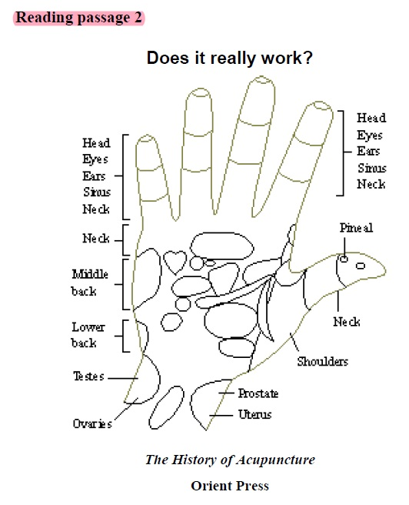
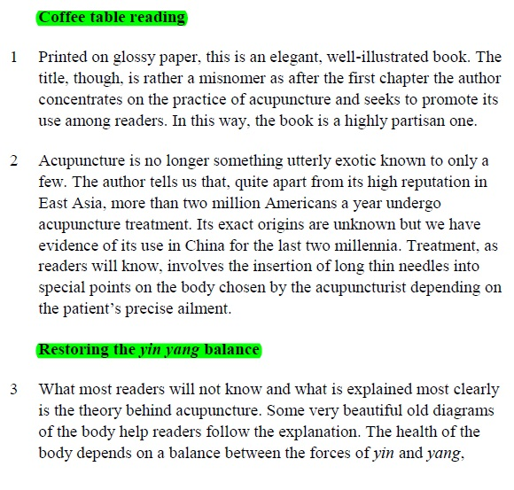

Slide 17
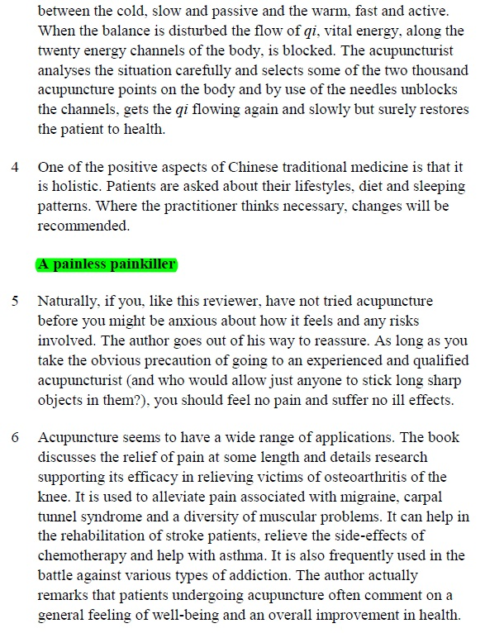
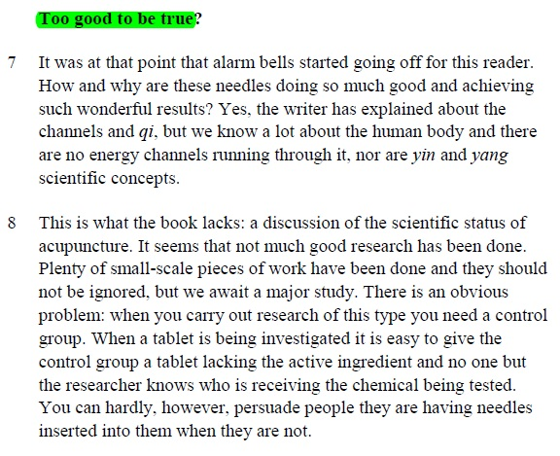

Slide 18
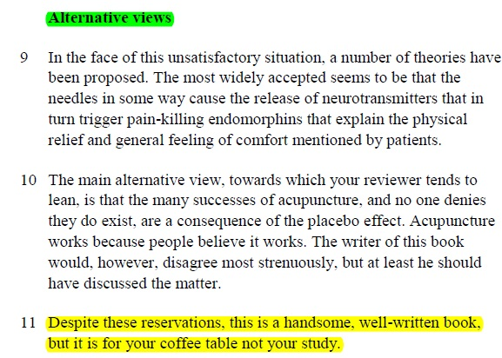

Slide 19
Skimming a text for its general meaning (P.7)
A book review will describe a book and its contents, move on to a more general discussion of some of the issues raised, comment on the strengths and weaknesses of the book, and suggest what sort of reader might benefit from/enjoy it.
Of course, you may be an expert on acupuncture, but an ordinary person faced with the word ‘acupuncture’ might predict that the following words could appear in the passage: ‘needles’, ‘Chinese’, ‘aches and pains’, ‘giving up smoking’, and ‘alternative/nonmainstream medicine’.

Slide 20
Activity 3.4 (p.8-10)
Set yourself a maximum time limit of two minutes for reading, and skim the review, using the suggestions above.
After you have skimmed the book review, answer the questions that follow.
Questions on p.10:
1 What do the picture, the sub-headings and the layout tell us in this book review?
2 What does the title tell us? Do you think it’s a helpful title for describing the main ideas in the review? Why/why not?
3 Having read the first and last paragraphs, what is the reviewer’s general view of the book?

Slide 21
Activity 3.4 (p.8-10) (Key)
1 What do the picture, the sub-headings and the layout tell us in this book review?
The picture, sub-headings and layout tell us this is a book review such as you might find in a magazine. The short paragraphs suggest a journalistic style designed for easy reading. The book being reviewed is about acupuncture.

Slide 22
Activity 3.4 (p.8-10) (Key)
2 What does the title tell us? Do you think it’s a helpful title for describing the main ideas in the review? Why/why not?
The title didn’t help much with establishing the topic, but it does help us in anticipating some of the content. The sub-editor, or whoever chose the title, obviously feels that an important theme in the review is the question of whether acupuncture really works or not. If so, we can expect to find arguments on both sides of the question and a dialogue between the author and the reviewer on the topic.

Slide 23
Activity 3.4 (p.8-10) (Key)
3 Having read the first and last paragraphs, what is the reviewer’s general view of the book?
The reviewer’s general opinion is that the book is attractive and well-written but is meant for non-experts. The reviewer also feels that the book’s author is somewhat biased in that he or she only takes a positive view of acupuncture.

Slide 24
Locating key ideas in a paragraph: using topic sentences (p.11)
Apart from relying on the key information in the other paragraphs to get the main ideas of the text, sometimes you can look at the topic sentences of the passage to identify key ideas.
It depends on the style of the text; whether topics sentences are explicit enough to make predictions regarding key ideas.
Topic sentences are usually the first sentences in each body paragraph, though there are exceptions for this.

Slide 25
Activity 3.6 (p.14)
Look at the key ideas in each of the topic sentences in the nanotechnology passage. Then match each of the paragraph summaries in the left column below with the paragraph that it describes.
4 minutes; individual
Passage is from p.11-13.

Slide 26
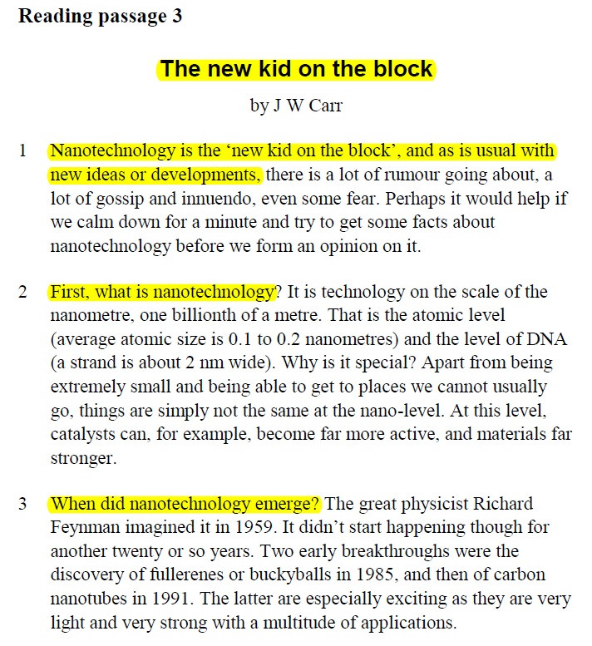
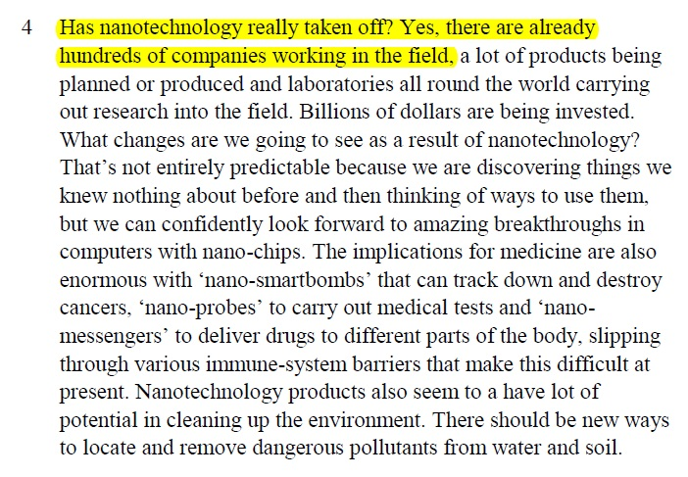

Slide 27
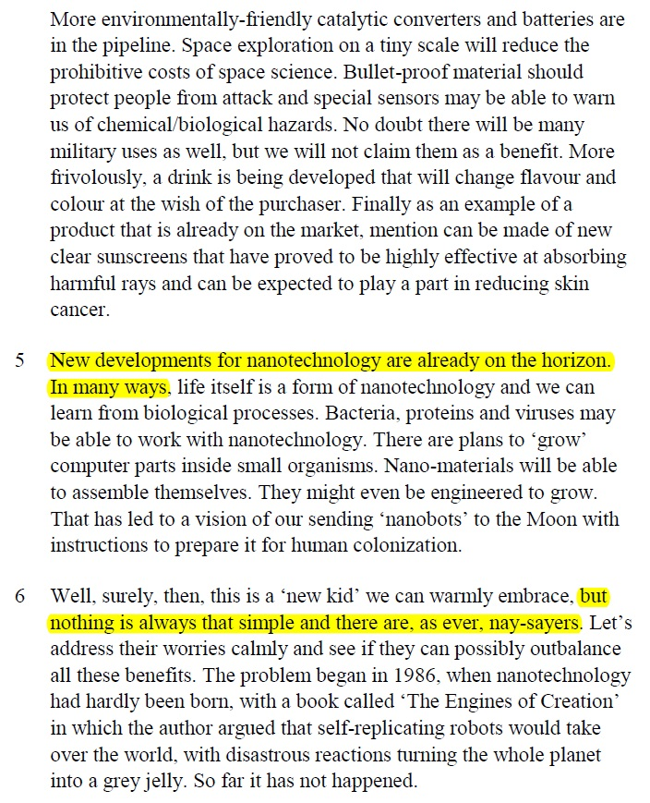
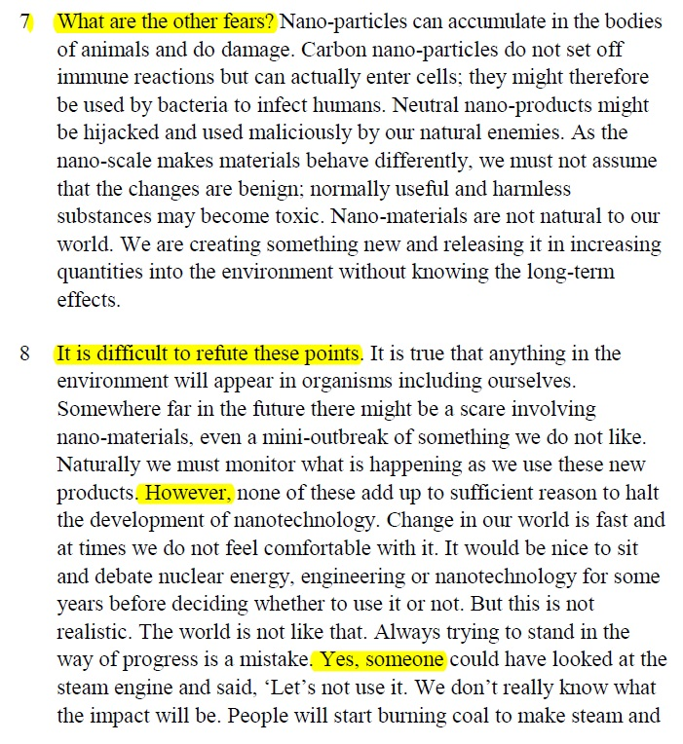

Slide 28
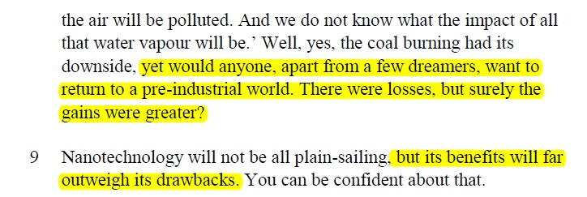

Slide 29









Paragraph summaries | Paragraph #
a Current applications of nanotechnology
b Nanotechnology is a very new kind of technology which some people are ignorant and even fearful of.
c Other fears and potential health and safety concerns
d Initial worries and fears about nanotechnology
e Ultimately, the benefits outweigh the potential risks.
f Definition of nanotechnology
g New and possible future developments
h History of the emergence and development of nanotechnology
i Fears are valid but they should not stop us from embracing the technology.

Slide 30
Activity 3.7 (p.15)
Now, go back to Reading passage 2 [p.8-10] (the book review ‘Does it really work: The History of Acupuncture’) and skim the topic sentences of the paragraphs.
Try to make a skeleton or outline of the text by completing the table below.
Use just a few words or a short sentence to describe the main point in each paragraph.
4 minutes; pair work

Slide 34


Activity 3.7 (p.15) (Key)
Paragraph # | Paragraph summaries
1
2
3
4
5
6
7
8
9
10
11

Slide 35
Understanding the logic and sequence of ideas in a text (p.16)
Some conventions for organizing writing logically
In most academic reading texts, writers follow some set rules or conventions for organizing their ideas. For example, a definition of a key topic is usually given at the beginning of a passage, and the historical background to a topic is described before its potential future development is discussed.
Also, general points are usually made before specific details are provided. Likewise, writers usually discuss solutions after they describe a problem. If writers are discussing more than one problem, they often describe and explain each one in a separate paragraph and usually describe a more serious problem after a less serious one.

Slide 36
Discourse markers (p.21)
Function | Discourse markers
Exemplifying | for example’, ‘for instance’, ‘such as’
Generalizing | ‘on the whole’, ‘by and large’, ‘basically’, ‘in general’
Joining or adding ideas | ‘and’ ‘also’ ’, ‘additionally’, ‘furthermore’, ‘moreover’, ‘as well’
Noting similarity | ‘similarly’, ‘in the same way’, ‘likewise’
Noting difference | ‘however’, ‘in contrast’, ‘on the other hand’, ‘though’
Signalling cause and effect | ‘therefore’, ‘so’, ‘as a consequence’, ‘consequently’, ‘as a result’, ‘thus
Sequencing stages or procedures | ‘first’, ‘secondly’, ‘fifthly’, ‘lastly’, ‘after this’, ‘then’
Summing up | ‘in short’, ‘in conclusion’

Slide 37
End of first half of Unit 3 ☺

Slide 38
ENGL E205F Preparing for IELTS Unit 3.2
Hazal Wong
hatwong@ouhk.edu.hk

Slide 39
Reading intensively: Scanning (p.23)
Having used a number of strategies to grasp the main points of a text, we now look at how to read more intensively. Reading intensively also involves a number of particular skills, which include:
• being able to scan (or locate specific information);
• using strategies for understanding the meanings of unfamiliar words;
• identifying synonyms and related words in a passage;
• gaining meaning from long and complex sentences; and
• being able to identify examples and supporting information.

Slide 40
Scanning (p.23)
Scanning involves identifying specific information quickly. This information might be numbers, measurements, a person’s name, a place, or a technical word or phrase.
Scanning is the technique you often use when looking up a name in the telephone book or a word in the dictionary.
In most cases, you know what words you are looking for, and so you can concentrate on finding particular information, rather than on trying to get the general meaning of a paragraph.

Slide 41
Activity 3.10 (p.24)
Scan the excerpt below from Reading passage 3 for the information that answers these questions: (2 minutes)
1 What is nanotechnology? (Hint: In which part of the text are you most likely to find a definition or an initial explanation of the main topic?)
2 How wide is a strand of DNA? (Hint: Note that you are looking for a number or measurement, which will be located close to the words ‘strand’ and ‘DNA’, or their synonyms.)
3 Who was the first scientist to pioneer nanotechnology? (Hint: You are looking for a name with capital letters.)
4 When did nanotechnology first emerge as a science? (Hint: You are looking for a date.)

Slide 42
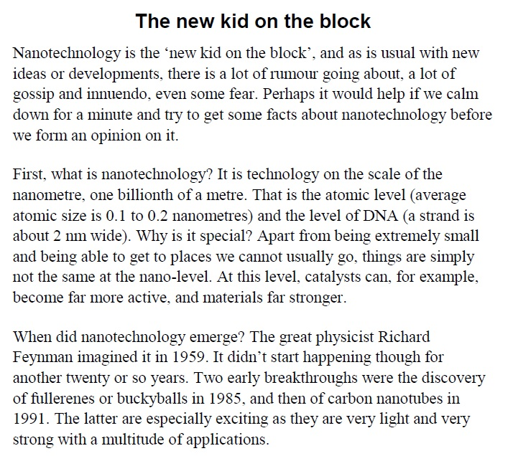

Slide 43
Activity 3.10 (p.24) (Key)
1 Nanotechnology is technology on the scale of the nanometre, one billionth of a metre.
2 A strand of DNA is about 2 nm wide.
3 The first scientist to pioneer nanotechnology was the physicist Richard Feynman.
4 Nanotechnology first appeared as a science in 1959.

Slide 44
Strategies for understanding the meanings of unfamiliar words (p.25)
• using the context of the word to guess its meaning
• using your existing knowledge of word roots, prefixes and suffixes
Using an unfamiliar word’s context
When you come across an unfamiliar word, you can understand its meaning by looking at the words before and after it and the sentences around it.

Slide 45
Using an unfamiliar word’s context (p.25)
For example, consider the meaning of ‘carbon nanotubes’ in the following paragraph:
When did nanotechnology emerge? The great physicist Richard Feynman imagined it in 1959. It didn’t start happening though for another twenty or so years. Two early breakthroughs were the discovery of fullerenes or buckyballs in 1985, and then of carbon nanotubes in 1991. The latter are especially exciting as they are very light and very strong with a multitude of applications.

Slide 46
Using an unfamiliar word’s context (p.25)
‘Fullerenes’ and ‘buckyballs’ are also unfamiliar technical words and they don’t help us much, but the next sentence gives us some clues and tells us that ‘carbon nanotubes’ have particular qualities and uses.
Next let’s practise our skills to work out the meaning of some less common words in a longer passage.

Slide 47
Activity 3.11 (p.25-27)
Refer to Reading passage 4 ‘America and drugs’ below.
Scan for the following words, then find clues to understand what each word means by looking at the context of each word:
(3 minutes)
By paragraph:
minimal 2 sedated 3 hyperactive, conform, dosage
4 alienate, lavish, advocates 6 nausea

Slide 48
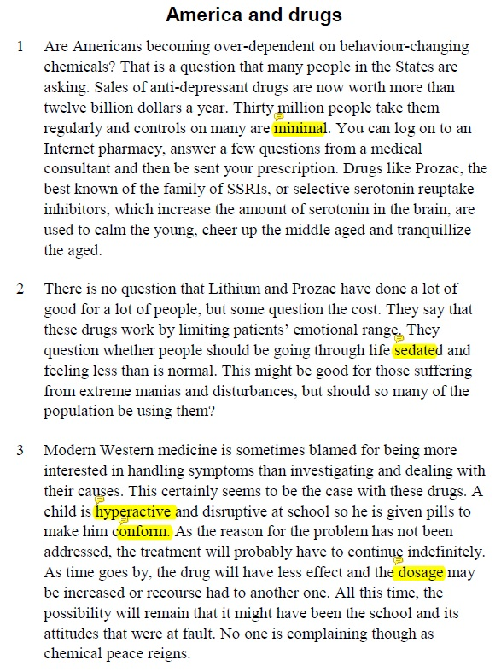
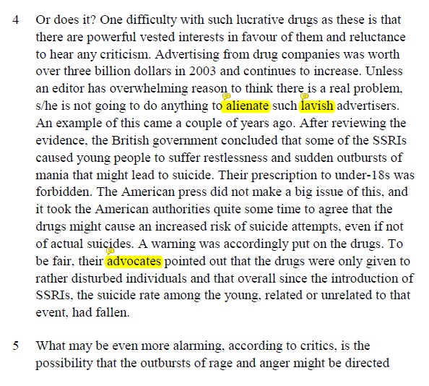

Slide 49
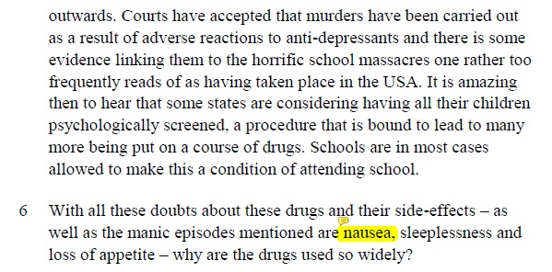

Slide 50
Activity 3.11 (p.25-27) (Key)
1 ‘minimal’ – very small
2 ‘sedated’ – chemically calmed
3 ‘hyperactive’ – very/too lively, unable to keep still; ‘conform’ – behave well, be like others; ‘dosage’ – amount of a medicine taken
4 ‘alienate’ – make unfriendly, upset; ‘lavish’ – big, generous; ‘advocates’ – supporters
6 ‘nausea’ – sickness, desire to vomit (There is not much help here, but you can guess it is one of the unpleasant feelings we get when ill.)

Slide 51
Using word form knowledge to guess the meaning of words (p.27)
This means looking for possible similarities between known and unfamiliar words.
It also involves using knowledge of a word’s Latin, French or Greek roots and of its prefix (first syllable) or suffix (last syllable).
Having some knowledge of the meaning of common roots, prefixes and suffixes can help you to guess the meaning of many unfamiliar and technical words.

Slide 52
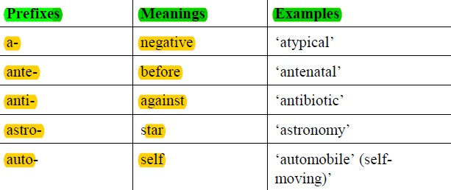
Using word form knowledge to guess the meaning of words (p.27-29)

Slide 53
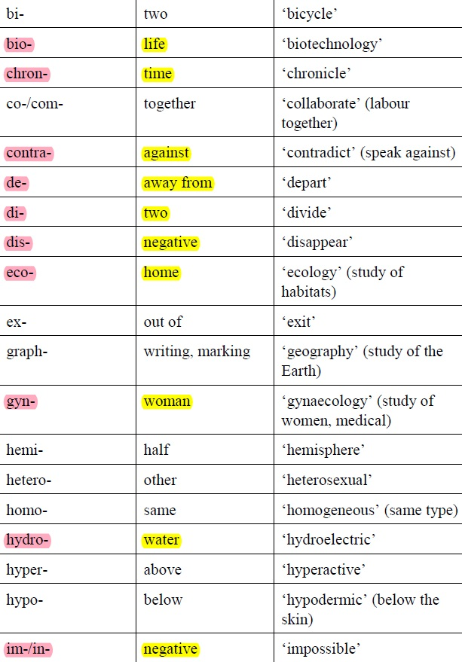
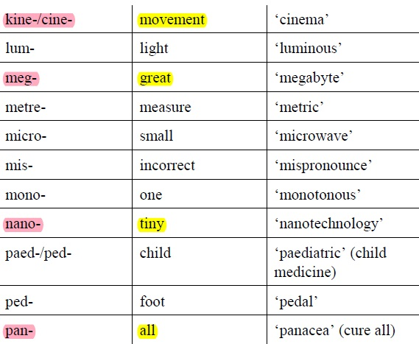

Slide 54
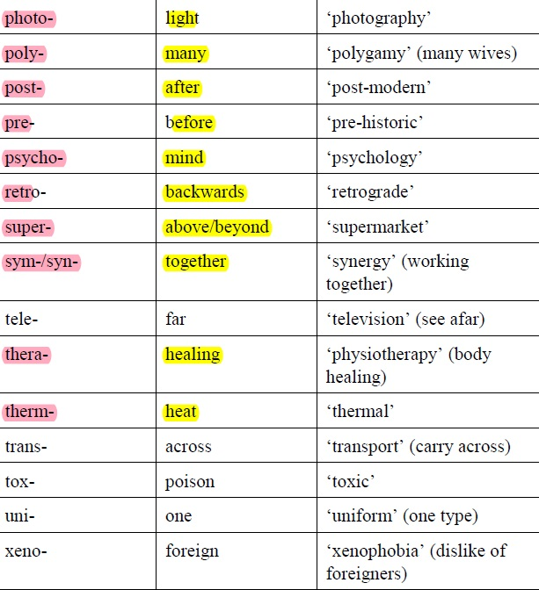
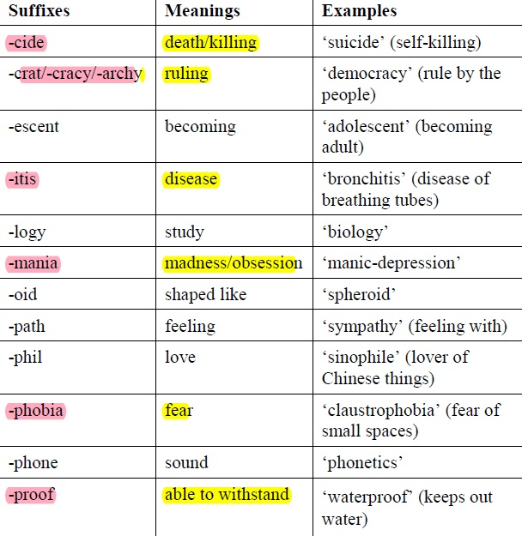

Slide 55
Identifying possible synonyms for key words and phrases (p.30)
If you are reading a passage to answer a comprehension question or to check a fact, you usually need to read intensively to find specific information.
Sometimes this process simply involves scanning for a specific word.
Sometimes, however, it also involves scanning a passage for a synonym of a key word or phrase.

Slide 56
Identifying possible synonyms for key words and phrases (p.30)
For example, imagine that you were reading the following paragraph from the ‘America and drugs’ text [p.31] in order to answer the following comprehension question:
TRUE or FALSE:
‘Anti-depressants are being used in America to make young people better behaved and to make people in their 40s and 50s feel happier.’

Slide 57
Identifying possible synonyms for key words and phrases (p.31)
America and drugs Are Americans becoming over-dependent on behaviour-changing chemicals? That is a question that many people in the States are asking. Sales of anti-depressant drugs are now worth more than twelve billion dollars a year. Thirty million people take them regularly and controls on many are minimal. You can log on to an Internet pharmacy, answer a few questions from a medical consultant and then be sent your prescription. Drugs like Prozac, the best known of the family of SSRIs, or selective serotonin reuptake inhibitors, which increase the amount of serotonin in the brain, are used to calm the young, cheer up the middle aged, and tranquillize the aged.

Slide 58
Identifying possible synonyms for key words and phrases (p.31)
In the above paragraph, most of the key words in the true-or-false question weren’t used.
If you were scanning the paragraph for phrases such as ‘better behaved’, ‘people in their 40s and 50s’ or ‘feel happier’, you would not find them.
However, you can find synonyms for these phrases (e.g. ‘the middle aged’ has the same meaning as ‘people in their 40s and 50s’ and ‘cheer up’ has the same meaning as ‘feel happier’).

Slide 59
Activity 3.13 (p.31)
The paragraph below discusses computer viruses.
Find words and phrases in the paragraph that mean the same as the ten synonyms in the left column below.
The answers should be in the same order as they appear in the text.
3 minutes; individual

Slide 60
Activity 3.13 (p.32)
Computer viruses Any computer connected to the Internet is under constant attack. This is a grim fact of cyberlife. Viruses and worms (the distinction is almost lost now) arrive in various guises and can cause serious damage. Messages about email that cannot be delivered and prizes we have won are common ways to get themselves on a computer. The wary know never to open them and to delete at once. Trojan horses are an ever-present danger allowing your machine to be remotely controlled from afar. Spyware is as nasty as it sounds along with its slightly less noxious cousin adware. Downloading free software is a risky business nowadays as often some malware gets in at the same time. These programmes slow down your computer, make your web browser behave in peculiar ways and generally degrade the performance of your machine.

Slide 61










Activity 3.13 (p.31) (Key)
 | Synonym | Word in passage
1 | Joined
2 | Continuous
3 | Unpleasant
4 | Difference
5 | Forms
6 | frequently used
7 | Careful
8 | Harmful
9 | software that harms
10 | odd

Slide 62
Unpacking complex sentences (p.32)
Recognizing concession
In academic arguments, writers often acknowledge (or ‘concede’) that there is more than one point of view.
To signal differences in opinion, writers often express two points of view by combining two contrasting clauses in one complex sentence.
They also often signal to the reader that one point of view has more importance than the other by placing the less important view first in the sentence – often preceded by a preposition that indicates some concession to a different or opposing argument.

Slide 63
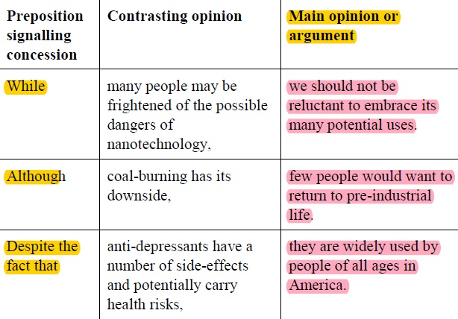
Unpacking complex sentences (p.33)

Slide 64
Activity 3.14 (p.33)
Examine the following complex sentences and, in your own words, paraphrase the main opinion or argument.
We will finish Q2 & 3. (2 minutes)
2 Although it is certainly not impossible, the theory may not strike one as especially plausible.
3 Despite many people’s desire to believe that life exists on other planets, there are no clear scientific signs that extra-terrestrial life exists.

Slide 65
Activity 3.14 (p.33) (Key)
2 Although it is certainly not impossible, the theory may not strike one as especially plausible.
Q2 It’s difficult to believe this theory.
3 Despite many people’s desire to believe that life exists on other planets, there are no clear scientific signs that extra-terrestrial life exists.
Q3 There’s no evidence that life exists on other planets.

Slide 66
Identifying an author’s opinions, attitudes and bias (p.36)
We now consider skills and strategies which help us to read critically and analytically, to determine a writer’s opinion, attitude and bias.
We look first at how to determine a writer’s attitude and assess whether it is positive or negative, subjective or neutral, certain or tentative.
We also look at strategies for identifying the intended audience of a piece of writing.

Slide 67
Identifying a writer’s attitude (p.36)
Signals of positive and negative attitudes
Emotive verbs, adjectives and adverbs often signal a writer’s attitude to the topic. These may be negative (‘awful’, ‘regrettable’, ‘nasty’) or positive (‘magnificent’, ‘splendid’).
For example, look at how the negative and emotive underlined words in the passage below connote the author’s belief that viruses are dangerous and a serious problem.

Slide 68
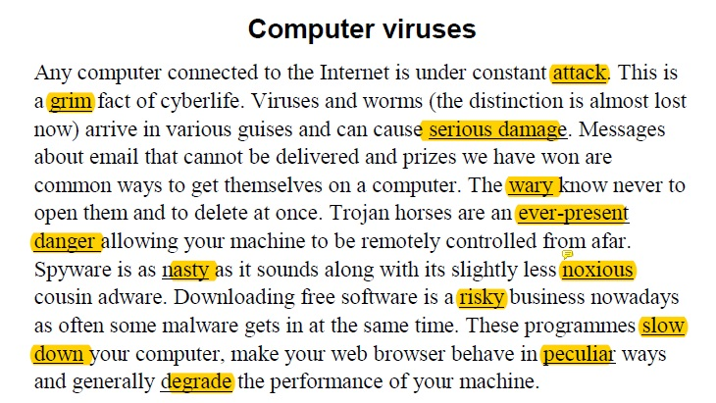
Identifying a writer’s attitude (p.36)

Slide 69
Identifying a writer’s attitude (p.36-37)
Sometimes, however, a writer takes neither a strongly negative nor strongly positive attitude. In these cases, the writer’s opinion can be called ‘neutral’.
Compare the strongly negative tone in the paragraph above with the neutral tone in the following paragraph.

Slide 70
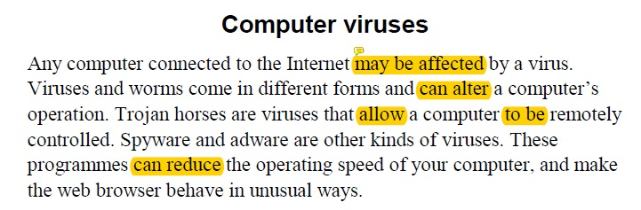
Identifying a writer’s attitude (p.36-37)

Slide 71
Assessing a writer’s level of certainty (p.37)
A writer’s attitude may be certain or uncertain.
Adverbs and prepositional phrases that signal certainty include:
Undoubtedly, … Clearly, … Without question, …
Noun phrases that use strong adjectives such as ‘a definite problem’, ‘clear facts’, or ‘undeniable and indisputable evidence’ signal a high degree of certainty.
In contrast, auxiliary modal verbs such ‘seem’, ‘may’, ‘appear’, ‘might’, and adverbs such as ‘perhaps’ soften an argument and make the writer seem less certain. Also, verbs such as ‘suggest’ and ‘indicate’ can also make a statement more tentative and less certain.

Slide 72
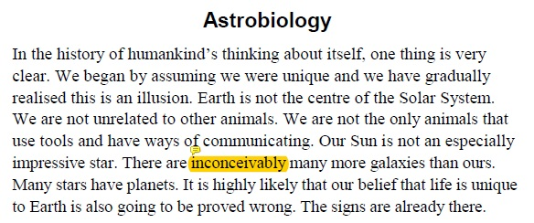
Activity 3.16 (p.37-38)
The paragraph below discusses whether life exists on other planets. What is the author’s attitude to this issue?
Underline any words that help you to determine the writer’s attitude to the question of life on other planets. How certain is the author of his/her opinions?

Slide 73
Activity 3.16 (p.37-38) (Key)
Astrobiology In the history of humankind’s thinking about itself, one thing is very clear. We began by assuming we were unique and we have gradually realised this is an illusion. Earth is not the centre of the Solar System. We are not unrelated to other animals. We are not the only animals that use tools and have ways of communicating. Our Sun is not an especially impressive star. There are inconceivably many more galaxies than ours. Many stars have planets. It is highly likely that our belief that life is unique to Earth is also going to be proved wrong. The signs are already there.
In this passage, the writer takes a strong position. Use of words such as ‘very clear’, ‘illusion’ and ‘highly likely’ indicate that the writer is making his/her claim with quite a lot of certainty. Also, the repeated use of ‘not’ to refute contradictory arguments reinforces the writer’s strong position.

Slide 74
Activity 3.17 (p.38-40)
Now read the passage that the above paragraph was taken from (Reading passage 5 below) and note the degree of certainty in the other paragraphs.
Mark the following statements as ‘very sure’ or ‘not completely sure’ according to the passage.
Remember to look for words that express doubt – for example, ‘maybe’, ‘possibly’, ‘could’, ‘might’ and ‘seem’ – or certainty, such as ‘definitely’, ‘it is clear that’, ‘obviously’ and ‘fact’.
Reading passage is from p.38-40

Slide 75
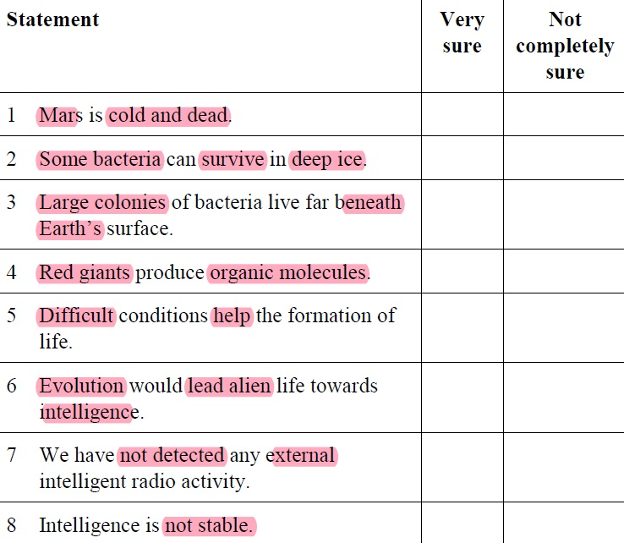


Activity 3.17 (p.38-40)

Slide 76
 For self-revision:
Determining the intended audience of a text (p.40-44)
Putting it all together (p.45-48)

Slide 77
End of Unit 3
Unit 7 – IELTS Reading
We will start Unit 4 (Listening skills) and Unit 6 (IELTS Speaking) next week ☺
See you very soon!

